Slide 1
MODULE 4
C++ Class Hierarchy
File Stream
Text File Handling
Binary File Handling during file operations
Pointer types-uses
Dynamic memory allocation techniques
Garbage collection
Linked list
Generic pointers

Slide 2
Introduction
In C++, I/O (Input/Output) Streams are used to perform input and output operations, such as reading from the keyboard or writing to the screen.
The term stream refers to a flow of data — either coming in (input) or going out (output).
iostream stands for standard input-output stream.
#include iostream declares objects that control reading from and writing to the standard streams.
In other words, the iostream library is an object-oriented library that provides input and output functionality using streams.
A stream is a sequence of bytes.
In C++ there are number of stream classes for defining various streams related with files and for doing input-output operations.
All these classes are defined in the file iostream.h.

Slide 3
Predefined Standard Input/Output Streams C++ language consists of four streams that are mainly defined for standard Input/Output.
The two operators, i.e., extraction operator (>>) and insertion operator (<<)are overloaded and are defined on basic or primary data types.
It is also possible to overload the extraction and insertion operators on the user-defined datatypes, but it can be possible for specific objects of the class.
The four streams are:
cin: It is mainly used to get the input from standard input device, such as keyboard.
cout: It is mainly used to display the output to standard output device, such as monitor or screen.
cerr: It is mainly used for standard error to display on monitor or screen.
clog:It is mainly used for buffered error to display on monitor.

Slide 4
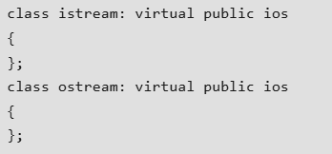
ios class is topmost class in the stream classes hierarchy. It is the base class for istream, ostream, and streambuf class.
istream and ostream serves the base classes for iostream class.
The class istream is used for input and ostream for the output.
Class ios is indirectly inherited to iostream class using istream and ostream.
To avoid the duplicity of data and member functions of ios class, it is declared as virtual base class when inheriting in istream and ostream as follows :

Slide 5
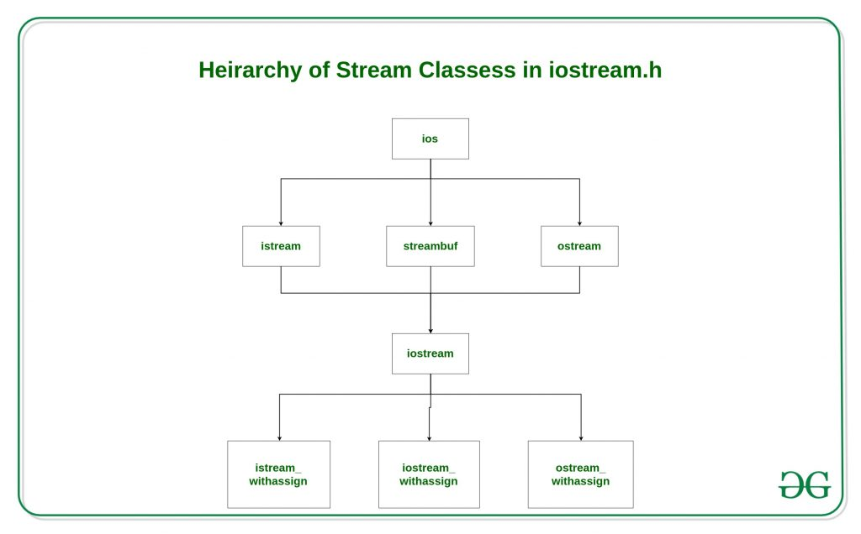
C++ Class Hierarchy

Slide 6
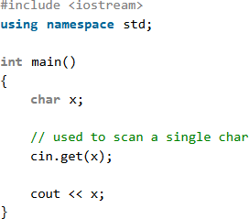
The _withassign classes are provided with extra functionality for the assignment operations that’s why _withassign classes.
The ios class: The ios class is responsible for providing all input and output facilities to all other stream classes.
The istream class: This class is responsible for handling input stream.
It provides number of function for handling chars, strings and objects such as get, getline, read, ignore, putback etc..

Slide 7
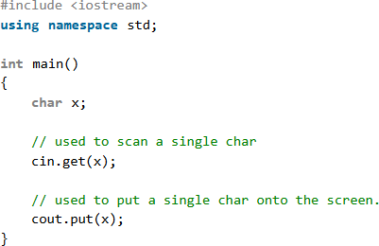
The ostream class: This class is responsible for handling output stream.
It provides number of function for handling chars, strings and objects such as write, put etc..

Slide 8
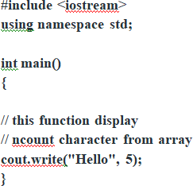
The iostream: This class is responsible for handling both input and output stream as both istream class and ostream class is inherited into it.
It provides function of both istream class and ostream class for handling chars, strings and objects such as get, getline, read, ignore, putback, put, write etc.

Slide 9
istream_withassign class: This class is variant of istream that allows object assignment.
The predefined object cin is an object of this class and thus may be reassigned at run time to a different istream object.
ostream_withassign class: This class is variant of ostream that allows object assignment.
The predefined objects cout, cerr, clog are objects of this class and thus may be reassigned at run time to a different ostream object.

Slide 10
File Stream
A file is a collection of related data stored in a particular area on the disk . The data is stored in disk using the concept of file .
Permanent storage of data : - (all the message or value printed with help of any output statements like cout , putchar are never available for future use ) .
If there is a large amount of data generated as output by a program, storing that output in file will help in easy handling /analysis of the output , as user can see the whole output at any time even after complete execution of the program.
If we need lot of data to be inputted, user cannot keep on typing that again and again for repeated execution of program.
In that case, all input data can be once written in a file and then that file can be easily used as the input file.
The transfer of input – data or output – data from one computer to another can be easily done by using files.

Slide 11
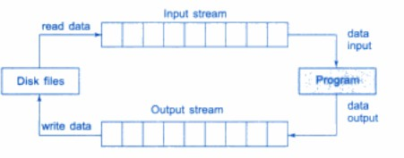
The I/O system of C++ handles file operations. It uses file streams as an interface between the programs and the files.
The stream that supplies data to the program is known as input stream and the one that receives data from the program is known as output stream.
The input stream extracts (or reads) data from the file and the output stream inserts (or writes) data to the file. This is illustrated in the following Fig.
The input operation involves the creation of an input stream and linking it with the program and the input file.
Similarly, the output operation involves establishing an output stream with the necessary links with the program and the output file.

Slide 12
Classes for File Stream Operations
In C++, file streams are used for input and output operations on files.
The standard file stream classes are part of <fstream> header.
The main classes for file stream handling in C++ are ifstream, ofstream and fstream.
These classes are derived from fstreambase and from the corresponding iostream class.
These classes, designed to manage the disk files, are declared in fstream and therefore we must include this file in any program that uses files.

Slide 13
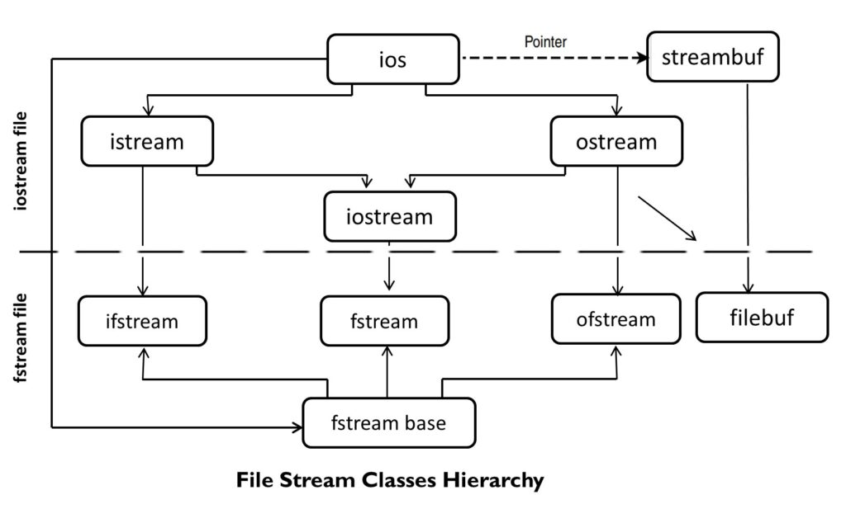

Slide 14
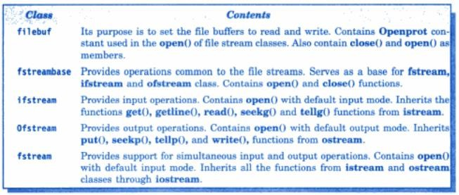

Slide 15
Opening and Closing a File
For using a disk file the following things are necessary
Suitable name of file, Data type and structure, Purpose and Opening Method.
The filename is a string of characters that makeup a valid filename for the operating system. It may contain two parts, primary name and optional period with extension.
Examples are Input.data, Test.doc etc.
For opening a file firstly a file stream is created and then it is linked to the filename.
A file stream can be defined using the classes ifstream, ofstream and fstream that contained in the header file fstream.
The class to be used depends upon the purpose whether the write data or read data operation is to be performed on the file.

Slide 16
A file can be opened in two ways:
Using the constructor function of class.
Using the member function open() of the class.
The first method is useful only when one file is used in the stream.
The second method is used when multiple files are to be managed using one stream.

Slide 17
Opening Files Using Constructor
A constructor is used to initialize an object while it is being created. Here, a filename is used to initialize the file stream object.
This involves the following steps:
Create a file stream object to manage the stream using the appropriate class. That is to say, the class ofstream is used to create the output stream and the class ifstream to create the input stream.
Initialize the file object with the desired filename.
For example, the following statement opens a file named "results" for output:
ofstream outfile("results"); // output only
This creates outfile as an ofstream object that manages the output stream.
This statement also opens the file results and attaches it to the output stream outfile.

Slide 18
Similarly, the following statement declares infile as an ifstream object and attaches it to the file data for reading (input).
ifstream infile("data"); // input only
The program may contain statements like:
outfile << "TOTAL"; outfile << sum; infile >> number; infile >> string;
The connection with a file is closed automatically when the stream object expires (when the program terminates).
When a file is opened for writing only, a new file is created if there is no file of that name.
If a file by that name exists already, then its contents are deleted and the file is presented as a clean file.

Slide 19
Opening Files Using open()
The function open() can be used to open multiple files that use the same stream object.
For example, we may want to process a set of files sequentially.
In such cases, we may create a single stream object and use it to open each file in turn.
The general form of the function open() with two arguments is:
stream-object.open("filename", mode);
The second argument mode (called file mode parameter) specifies the purpose for which the file is opened.
The prototype of class member functions contain default values for the second argument and therefore it uses the default values in the absence of the actual values.

Slide 20

The default values are as follows:
ios::in for ifstream functions meaning open for reading only.
ios::out for ofstream functions meaning open for writing only.
The file mode parameter can take one (or more) of such constants defined in the class ios.

Slide 21
//Creating files with open() function
#include<iostream.h>
#include<conio.h>
#include<stdio.h>
#include<stdlib.h>
#include<fstream.h>
int main() {
ofstream fout;
fout.open(“country”);
fout<<”United states of America \n”;
fout<<”United Kingdom”;
fout<<”South korea”;
fout.close();

Slide 22
fout.open(“capital”);
fout<<”Washington\n”;
fout<<”London\n”;
fout<<”Seoul \n”;
fout.close();
const int N =80;
char line[N];
ifstream fin;
fin.open(“country”);
cout<<”contents of country file \n”;

Slide 23
while (fin) {
fin.getline(line,N);
cout<<line;
}
fin.close();
fin.open(“capital”);
cout<<”contents of capital file”;
while (fin) {
fin.getline(line,N);
cout<<line;
}
fin.close();

Slide 24
fin.open(“capital”);
cout<<”contents of capital file”;
while(fin) {
fin.getline(line,N);
cout<<line;
}
fin.close();
return 0;
}

Slide 25
Text File Handling
Text File Handling is a process in which we create a text file and store data permanently on a hard disk so that it can be retrieved from the memory later for use in a program. In a text file, whatever data we store is treated as text. Even if we store numbers, it is treated as text.
The ofstream is a type of output stream in C++ that is used to write data to a file. We must include the fstream header file in our program to use the ofstream class.
ofstream object_name;
object_name.open("file_name");
The ifstream is a type of input stream in C++ that is used to read data from a file. We must include the fstream header file in our program to use the ifstream class.
ifstream object_name;
object_name.open("file_name");

Slide 26
The fstream is a type of file stream in C++ that is used for reading from, writing to, and manipulating files. We must include the fstream header file in our program to use the fstream class.
fstream object_name;
object_name.open("file_name", mode);
There are different types of operations that we can perform on a text file, they are:
Create a new file.
Open an existing file.
Write to a file.
Read from a file.
Copy a file from one location to another.
Rename a file.
Delete a file.

Slide 27
Binary File handling during file operations
Binary File Handling is a process in which we create a file and store data in its original format. It means that if we stored an integer value in a binary file, the value will be treated as an integer rather than text.
Write to a file and Read from a file
To write a binary file in C++ use write() method. It is used to write a given number of bytes on the given stream, starting at the position of the "put" pointer.
The file is extended if the put pointer is currently at the end of the file. If this pointer points into the middle of the file, characters in the file are overwritten with the new data.
If any error has occurred during writing in the file, the stream is placed in an error state.

Slide 28
To read a binary file in C++ use read() method.
It extracts a given number of bytes from the given stream and place them into the memory, pointed to by the first parameter.
If any error is occurred during reading in the file, the stream is placed in an error state, all future read operation will be failed then.
gcount() can be used to count the number of characters has already read.
Then clear() can be used to reset the stream to a usable state.

Slide 29
Pointer types
Each file has two associated pointers known as the file pointers.
One of them is called the input pointer (or get pointer) and the other is called the output pointer (or put pointer).
The input pointer is used for reading the contents of a given file location and the output pointer is used for writing to a given file location.
Each time an input or output operation takes place, the appropriate pointer is automatically advanced.
When we open a file in read-only mode, the input pointer is automatically set at the beginning so that we can read the file from the start. Similarly, when we open a file in write-only mode, the existing contents are deleted and the output pointer is set at the beginning. This enables us to write to the file from the start. In case, we want to open an existing file to add more data, the file is opened in 'append' mode. This moves the output pointer to the end of the file (i.e. the end of the existing contents).

Slide 30
Functions for Manipulation of File Pointers
The file stream classes support the following functions to manipulate file pointers:
seekg() : Moves get pointer (input) to a specified location.
seekp() : Moves put pointer(output) to a specified location.
tellg() : Gives the current position of the get pointer.
tellp() : Gives the current position of the put pointer.

Slide 31
fout . seekg(0, ios :: beg) -- go to start
fout . seekg(0, ios :: cur) -- stay at current position
fout . seekg(0, ios :: end) -- go to the end of file
fout . seekg(m, ios :: beg) -- move to m+1 byte in the file
fout . seekg(m, ios :: cur) -- go forward by m bytes from the current position
fout . seekg(-m, ios :: cur) -- go backward by m bytes from the current position
fout . seekg(-m, ios :: end) -- go backward by m bytes from the end

Slide 32
Dynamic memory allocation techniques
The means by which data object can be created as they are needed during the program execution. Such data objects remain in existence until they are explicitly destroyed.
In C++, dynamic memory allocation is accomplished with the operators new (for creating data objects) and delete (for destroying them).
C++ allows us to allocate the memory dynamically in run time. This is known as dynamic memory allocation.
In C++, we need to deallocate the dynamically allocated memory manually after we have no use for the variable.
We can allocate memory dynamically using the new operator and deallocate memory dynamically using the delete operator.

Slide 33
new Operator
The “new” operator in C++ is used to allocate memory dynamically for a variable or an object at runtime. This means that the memory is allocated during the execution of the program, as opposed to being allocated at compile time. When the “new” operator is called, it reserves a block of memory that is large enough to hold the object being created and then returns a pointer to the first byte of that memory block.
Syntax to initialize the memory
pointer_name=new datatype;
Example : int *ptr=new int;
Syntax to allocate a block of memory
pointer_variable = new datatype(value);
Example : int *ptr=new int(10);

Slide 34
Delete Operator
The delete operator is used to deallocate memory that was previously allocated on the heap using new. It takes a pointer to the memory to be deallocated as an argument.
For example: delete p; // Deallocates the memory pointed to by p
The “delete” operator is used to deallocate memory that the “new” operator previously allocated. Once a block of memory has been allocated by “new,” it is important to deallocate it when it is no longer needed so that other parts of the program can reuse the memory. The “delete” operator releases the memory back to the system, and other parts of the program can use it.
Memory leaks occur when the program allocates memory dynamically but does not deallocate it properly. This causes the program to consume more memory gradually, eventually leading to poor performance or even crashing the program. Use delete to deallocate memory allocated with new to avoid memory leaks.

Slide 35
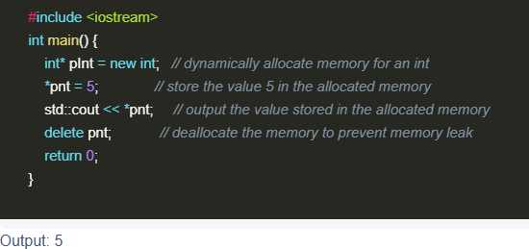

Slide 36
Garbage collection
C++ does not have automatic garbage collection, meaning programmers are responsible for manually managing memory allocation and deallocation, which can lead to memory leaks if not done correctly.
Unlike languages like Java or Python, C++ doesn't have a built-in garbage collector that automatically reclaims memory when it's no longer in use.
C++ programmers must explicitly allocate memory using new and deallocate it using delete.
If memory is allocated but not deallocated when it's no longer needed, it can lead to memory leaks, where the program continues to consume memory even after it's no longer required.

Slide 37
Why manage garbage collection?
Managing garbage collection in C++ is important for several reasons.
First, it can help you avoid memory leaks, which occur when you allocate memory but forget to free it when it is no longer needed. Memory leaks can cause performance degradation, resource exhaustion, and unexpected errors.
Second, it can help you reduce memory fragmentation, which occurs when you allocate and free memory in different sizes and patterns. Memory fragmentation can make it harder to find contiguous blocks of memory for new allocations and increase the overhead of memory management.
Third, it can help you improve memory efficiency, which means using the optimal amount of memory for your program's needs and avoiding wasting memory on unused or unnecessary data.

Slide 38
Managing garbage collection manually
Managing garbage collection in C++ manually, using the operators new and delete , provides full control over memory allocation and deallocation.
However, it can be a tedious and time-consuming task, particularly for complex programs that involve multiple layers of abstraction, inheritance, polymorphism, and dynamic allocation.
Common mistakes that can lead to memory leaks or corruption include forgetting to delete a pointer or an object after use, deleting a pointer or an object more than once, deleting a pointer or an object

Slide 39
Managing garbage collection with smart pointers
In C++, another way to manage garbage collection is through smart pointers. These objects wrap around raw pointers and automatically free the memory they point to when they go out of scope or are reassigned.
Smart pointers can simplify memory management and reduce the risk of memory leaks or corruption, but they also come with some drawbacks, such as overhead to memory operations, creating circular references that prevent memory from being freed, introducing compatibility issues with legacy code or libraries that use raw pointers, and changing the semantics and behavior of pointer operations.
C++ provides several types of smart pointers with different characteristics and use cases.
The most common ones are std::unique_ptr , which is useful for managing resources that have a single owner and a clear lifetime; std::shared_ptr , which is useful for managing resources that have multiple owners and a dynamic lifetime; and std::weak_ptr , which does not own the memory it points to and does not affect the reference count of a std::shared_ptr . It can be used to break circular references or to access resources that may or may not exist.

Slide 40
Managing garbage collection with RAII
RAII stands for Resource Acquisition Is Initialization, a programming idiom that binds the lifetime of a resource to the lifetime of an object.
In C++, this means using constructors to acquire resources and destructors to release them, so that resources are automatically freed when the objects that own them are destroyed.
RAII can be used to manage not only memory, but also other types of resources, such as files, sockets, locks, threads, etc.
This programming technique can offer several advantages, such as ensuring that resources are always released even in the case of exceptions or early returns.
It also avoids the need to write explicit cleanup code or use try-finally blocks, making the code more readable, concise and consistent while supporting the principle of single responsibility and separation of concerns.

Slide 41
To implement RAII in C++, you can either use existing RAII classes like smart pointers, containers, streams and locks or create your own by defining a class that represents a resource and encapsulating its acquisition and release in the constructor and destructor respectively.
Additionally, you should disable or appropriately implement the copy constructor and copy assignment operator while providing accessors and operators to manipulate the resource as needed.

Slide 42
Generic pointers
In C++, a generic pointer, also known as a void pointer, is a special type of pointer that can point to data of any type.
A void pointer (void *) is a special type of pointer in C and C++ that is used to point to data of unspecified type. It is often used where the type of data being pointed to may vary or is not known at compile time.
It is declared as void *. This allows a single pointer to hold the address of different data types without requiring explicit type conversions during assignment. However, to use a void pointer, you must cast it to the appropriate type before dereferencing.
In C++, a generic pointer is typically used to refer to a pointer that can point to any data type. C++ does not have a direct "generic pointer" type like some languages, but you can achieve similar functionality by using the void* type or through template classes/functions.

Slide 43
Key characteristics and uses of void pointers :
1. Type-agnostic: Void pointers don't have a specific data type associated with them, making them suitable for situations where the type of the data being pointed to is not known or can vary.
2. Memory allocation: Functions like malloc() and calloc() return void pointers, allowing you to allocate memory without specifying the type of data it will store.
3.Generic functions: Void pointers are used in C and C++ to implement generic functions, where the function can work with different data types without knowing the exact type in advance.
4.qsort(): The qsort() function in the C standard library uses void pointers for the array to be sorted and the comparison function, enabling sorting of different data types.

Slide 44
In C++, we cannot assign the address of a variable of one data type to a pointer of another data type. Consider this example:
//pointer is of int type
int *ptr;
// variable is of double type
double d = 9.0;
// Error
// can't assign double* to int*
ptr = &d;
Here, the error occurred because the address is a double type variable. However, the pointer is of int type.
In such situations, we can use the pointer to void (void pointers) in C++.

Slide 45
//void pointer
void *ptr;
double d = 9.0;
// valid code
ptr = &d;
The void pointer is a generic pointer that is used when we don't know the data type of the variable that the pointer points to.

Slide 46
#include <iostream>
using namespace std;
int main() {
void* ptr;
float f = 2.3f;
// assign float address to void
ptr = &f;
cout << &f << endl;
cout << ptr << endl;
return 0;
}
Here, the pointer ptr is given the value of &f.

